Slide 1

Paramore

Slide 2
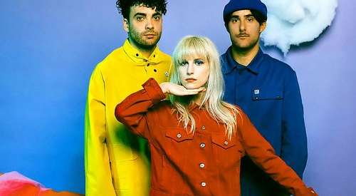
Stats
Fifth Studio Album After Laughter hit #5 on Billboard
Over 120,000 copies sold worldwide
“Ain’t It Fun” Grammy-winning single, 2X Platinum
25.8 Million in Total Record Sales
Hit Single “Hard Times” Certified Silver

Slide 3
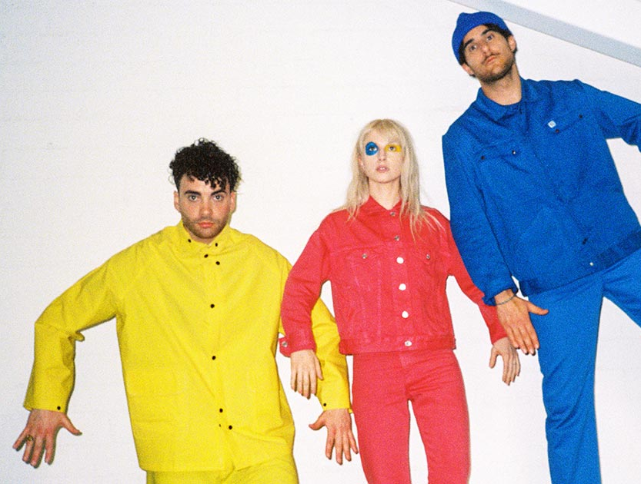
“Paramore's 'After Laughter' Triumphs Via Shiny Pop, Moody Lyrics” 4 out of 5 – Rolling Stone
“You’d be forgiven for missing the seriousness on After Laughter for just how much damn fun it is.” –Consequence of Sound
“After years of merrily keeping the Paramore lights on, Hayley Williams considers her life and lets go of her grin on her latest album, a fizzy yet despondent piece of ’80s pop-rock.” 7.5/10 Pitchfork

Slide 4



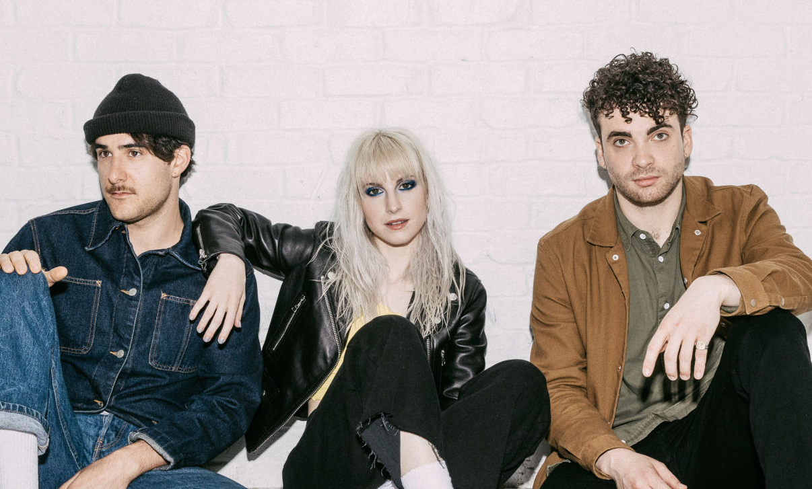
Social
1.9 Million
25.9 Million Likes
5.81 Million

Slide 5

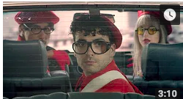
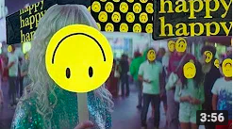

Videos
Hard Times Music Video
Told You So Music Video
Fake Happy Music Video
Rose Colored Boy Music Video

Slide 6






Genuine
Honest
Punk
Rock N roll
Quirky
Talented
Fun
Creative

Slide 7
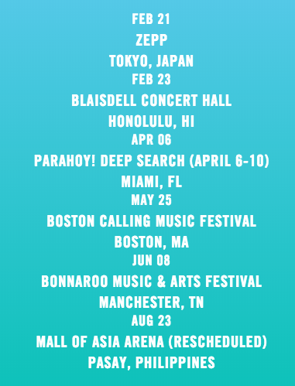

What’s Next?
Tour
Cruise

Slide 8
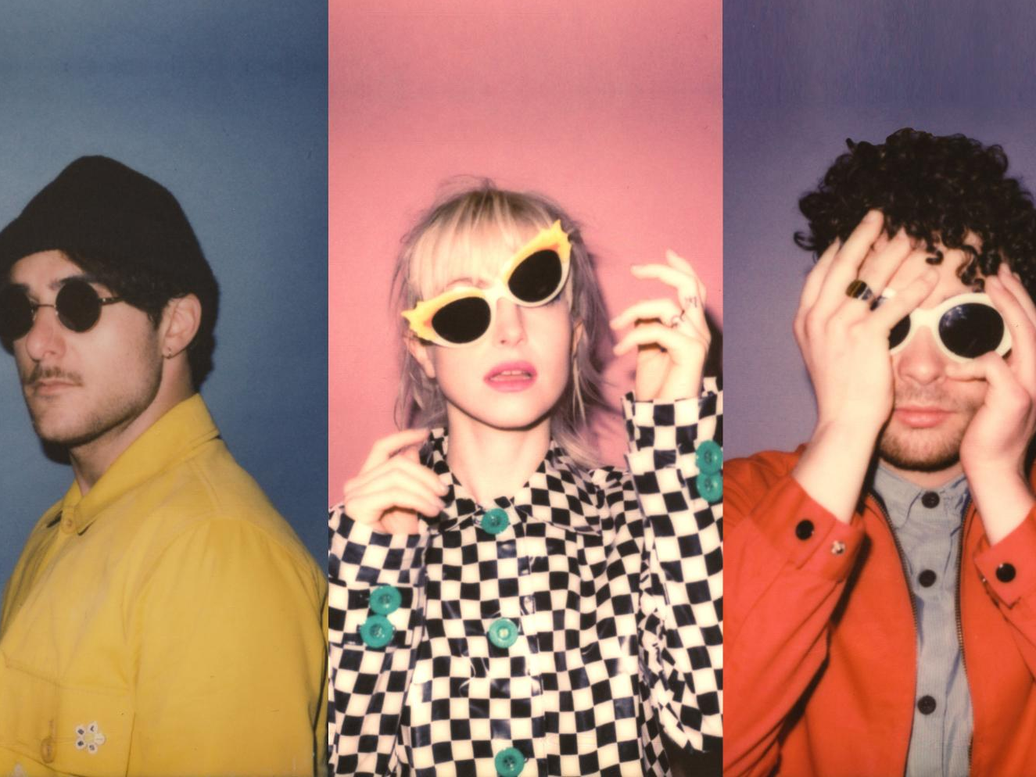
Sources
Dombal, Ryan. “Paramore: After Laughter.” Paramore: After Laughter Album Review, Pitchfork, 15 May 2017, pitchfork.com/reviews/albums/23237-after-laughter/.
Ezell, Brice. “Paramore- After Laughter.” Consequence of Sound, 15 May 2017, www.consequenceofsound.net/2017/05/album-review-paramore-after-laughter/.
Johnston, Maura. “Review: Paramore’s ‘After Laughter’.” Rolling Stone, 12 May 2017, www.rollingstone.com/music/albumreviews/review-paramores-after-laughter-w482045.
“Paramore Chart History.” Billboard, www.billboard.com/music/paramore/chart-history.
http://www.paramore.net/
https://www.youtube.com/channel/UCc7_woMAIVIW2mAr1rPCsFQ

